Slide 1
CS 6910 – Pervasive Computing
Spring 2007
Section 8 (Ch.8):
Traffic Channel Allocation
Prof. Leszek Lilien
Department of Computer Science
Western Michigan University
Slides based on publisher’s slides for 1st and 2nd edition of:
Introduction to Wireless and Mobile Systems by Agrawal & Zeng
© 2003, 2006, Dharma P. Agrawal and Qing-An Zeng. All rights reserved.
Some original slides were modified by L. Lilien, who strived to make such modifications clearly visible. Some slides were added by L. Lilien, and are © 2006-2007 by Leszek T. Lilien. Requests to use L. Lilien’s slides for non-profit purposes will be gladly granted upon a written request.

Slide 2
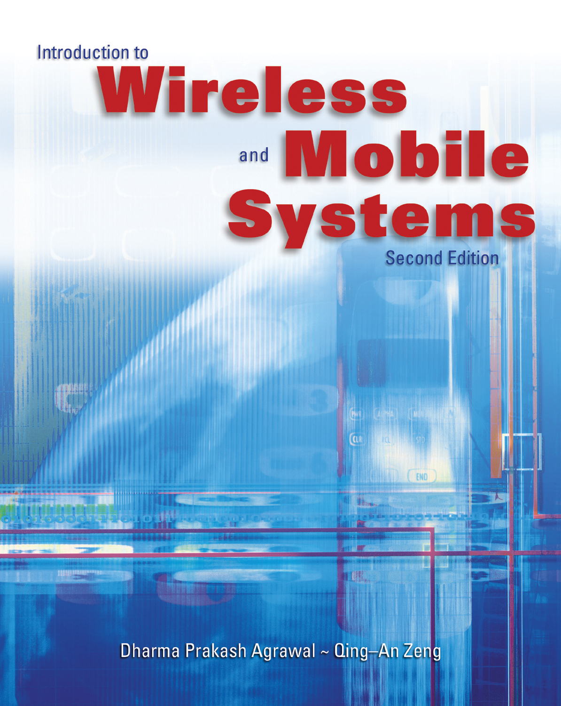
Chapter 8
Traffic Channel Allocation
(Modified by LTL)

Slide 3
Traffic Channel Allocation
Outline
8.1. Introduction
8.2. Static Allocation vs. Dynamic Allocation
8.3. Fixed Channel Allocation (FCA)
8.4. Dynamic Channel Allocation (DCA)
8.5. Other Channel Allocation Schemes
8.6. Allocation in Specialized System Structures
8.7. System Modeling
(Modified by LTL)

Slide 4
8.1. Introduction
Channel allocation task:
How a BS should assign traffic channels to MSs
  Upon MS request
    Remember: MSs do not request control channels!
    They compete for them!
  If unavailable – MS is blocked
Minimizing MS blocking:
  Increase # of channels per cell
    There’s a limit to this #
      Due to limited frequency band allocated for given wireless comm system
        E.g. a cellular system
© 2007 by Leszek T. Lilien

Slide 5
8.1. Introduction – cont.
Channel allocation task – another view:
How a given radio spectrum is divided into a set of disjoint channels that can be used simultaneously while minimizing interference in adjacent channel
Allocation approaches:
  1) Allocate channels equally among cells
    Using appropriate re-use distance
  2) Allocate channels to cells according to their traffic load
    Problem: difficult to predict traffic
  => begin with Approach 1 (allocate channels equally), modify it later (as discussed below)
© 2007 by Leszek T. Lilien

Slide 6
8.2. Static Allocation vs. Dynamic Allocation
Channel allocation schemes
  1) Static channel allocation = fixed channel allocation (FCA)
  2) Dynamic channel allocation (DCA)
  3) Other channel allocation schemes
Many alternatives or variations within each scheme
© 2007 by Leszek T. Lilien

Slide 7
8.2. Static Allocation vs. Dynamic Allocation
1) Static channel allocation = fixed channel allocation (FCA)
  Available channels divided among cells
    Now each cell owns some channels
  FCA types:
    Uniform FCA – same # of channels allocated to each cell
    Nonuniform FCA – different # of channels allocated to different cells
2) Dynamic channel allocation (DCA)
  No channel owned by any cell
  All channels are in a channel pool
  Any cell may ask for a free channel from the pool
3) Other channel allocation schemes
  Hybrid channel allocation (HCA)
    Combines FCA and DCA
  Flexible channel allocation
  Handoff channel allocation
© 2007 by Leszek T. Lilien

Slide 8
8.3. Fixed Channel Allocation (FCA)
Fixed channel allocation (FCA) principle:
A set of channels permanently allocated to each cell in the system
Minimum number of channel sets N required to serve the entire coverage area
N = D² / 3R²
where: D - frequency reuse distance D / R - cell radius
Shortcoming of FCA - due to short-term fluctuations in traffic
  FCA unable to keep up with increased traffic
    With traffic larger than fixed # of channels acommodates
  FCA unable to maintain high QoS
    QoS = quality of service
Solution: Borrow free channels from neighboring cells
  Many channel-borrowing schemes
(Modified by LTL)

Slide 9
8.3.1. Simple Channel Borrowing (CB) Schemes
Principles of simple CB schemes
  Can borrow from any adjacent cell that has unused channels
    If needed to accommodate new calls / Or to keep up QoS
  Acceptor cell that has used all its nominal channels can borrow free channels from a neighboring donor cell
  Borrowed channel must not interfere with existing calls
Possible donor cells for Sector X of Cell 3
Cell 3 (acceptor cell)
1
2
X
Y
Z
A call initiated in Sector X of Cell 3 can borrow a channel from adjacent Cells 1 or 2
(Modified by LTL)

Slide 10
8.3.1. Simple Channel Borrowing (CB) Schemes – cont.
Two of the alternative borrowing schemes: (more later)
  Borrow from the richest – borrow from an adjacent cell which has largest number of free channels
  Borrow first available – select the first free channel found in any neighboring cell
Channel reassignment – return the borrowed channel when a nominal channel becomes free in the cell
(Modified by LTL)

Slide 11
More Simple Channel Borrowing (CB) Schemes
Scheme | Description
Simple Borrowing (SB) | A nominal channel set is assigned to a cell, as in the FCA case. After all nominal channels are used in an acceptor cell, an available channel from a neighboring donor cell is borrowed.
Simple Borrowing from the Richest (SBR) | Channels that are candidates for borrowing are available channels nominally assigned to one of the adjacent cells of the acceptor (borrowing) cell. If more than one adjacent cell has channels available for borrowing, a channel is borrowed from the cell with the greatest number of channels available for borrowing.
Basic (borrowing) Algorithm (BA) | This is an improved version of SBR which takes channel locking into account when selecting a candidate channel for borrowing. This scheme tries to minimize the future call blocking probability in the donor cell that is most affected by the channel borrowing.
Basic Algorithm with Reassignment (BAR) | Transfer a call from a borrowed channel to a nominal channel as soon as a nominal channel becomes available (i.e., return borrowed channel ASAP)
Borrow First Available (BFA) | Instead of trying to optimize when borrowing, borrow the first candidate channel found.

Slide 12
8.3.2. Complex Channel Borrowing (CB) Schemes
Complex CB – basic solution
  Cell channels divided into 2 groups:
    1) Channels reserved for own use by the cell that owns them
    2) Channels that can be borrowed to neighbors
Complex CB – priority-based solution
  N cell channels assigned priorities: 1, 2, …N
  Highest pri channels used by the owner cell as needed
    In the order: 1, 2, 3…
  Lowest pri channels borrowed when asked for
    In the order: N, N-1, N-2, …
(Modified by LTL)

Slide 13
8.3.2. Complex Channel Borrowing (CB) Schemes – cont.
Additional factors considered in borrowing cells
  Minimize interference
  Minimize possibility of blocking calls in the donor
  Borrow from neighboring sectors only
    Not just from neighboring cells
  Donor cell keeps highest-quality channels for itself

Slide 14
Impact of Channel Borrowing in Sectored Cell-based Wireless System
Consider co-channel interference for seven adjacent clusters
  Assume that corresponding sectors of all corresponding cells use the same frequency
    E.g., freq’s a, b, c
  Minimize interference for freq. reuse
Supp. that Sector x of Cell A3 borrows channel from Sector a of Cell A1
  Problem - Violation of reuse distance:
  Freq. originally used in A1-a is used in A3-x
    Closer to A3-a or A4-a or A2-a
A₇
c
a
A₂
b
c
a
b
A₆
c
a
A₁
b
c
a
A₃
b
x
c
a
b
A₅
c
a
A₄
b
c
a
b
x borrows some channels from a
(Modified by LTL)

Slide 15
Recall: Problem - Violation of reuse distance:
  Freq. originally used in A1-a is used in A3-x
    Closer to A3-a or A4-a or A2-a
Not a real problem if antenna directionality is appropriate
  Look at directions of antenna for x in Sector A3 (fig. on previous slide)
  Sectors A3-a and A4-a are “behind” the antenna for A3-x
  Sector A2-a is reached by signals emitted from antenna for A3-x
Such analysis of potential interference is needed whenever a channel is borrowed
  Whether borrowed from a cell in a neighboring cluster (as shown above) or from a cell in own cluster
  As illustrated, analysis looks at:
    1) reuse distance
    2) sector’s antenna directionality
© 2007 by Leszek T. Lilien

Slide 16
8.4A. Dynamic Channel Allocation (DCA)
DCA scheme principles:
  All channels for all cells kept in a central channel pool
    No channel “owned” by any cell
      In FCA, sets of channels were owned by cells
  Channel assigned dynamically to new calls
    Select the most appropriate free channel for a given call
        Based simply on current channel allocation and current traffic
      With the aim of minimizing the interference
      => DCA can overcome the problems of FCA
  After a call is completed, the channel is returned to the pool
DCA variations center around the different cost functions used for selecting one of the candidate channels for a given call
© 2007 by Leszek T. Lilien

Slide 17
8.4A. Dynamic Channel Allocation (DCA) – cont.
DCA schemes:
  Centralized
  Distributed
Centralized DCA scheme:
a single controller selecting a channel for each cell
Distributed DCA scheme:
a number of collaborating controllers scattered across the network
  MSCs are these controllers
    Recall: MSC = mobile switching center – “above” BS, below PSTN connection
© 2007 by Leszek T. Lilien

Slide 18
8.4A.1. Centralized DCA Schemes
Recall: DCA selects a “free” channel from a pool
IMPORTANT: What is a “free” channel?
  Free channel does not mean a channel not used at all (by any cell)!
  Free means one that can be reused without undue interference
    I.e., without undue interference with other cells in its co-channel set
      Co-channel set = set of identical channels reused by different cells (must keep reuse distance to keep interference under control)
How to select a free channel from the central pool
  One that maximizes # of members in its co-channel set =
  one that allows for maximum # of cells reusing it
        Such channel maximizes the # by minimizing the mean square of distance between cells using the same channel
    E.g., Candidate 1 can be reused in 5 cells, Candidate 2 can be reused in 3 cells => select Candidate 1
© 2007 by Leszek T. Lilien

Slide 19
8.4A.1. Centralized DCA Schemes – cont. 1
Scheme | Description
First Available (FA) | The simplest DCA scheme. Selects the first available channel satisfying the reuse distance requirement encountered during a channel search. The FA strategy minimizes the computational time.
Locally Optimized Dynamic Assignment (LODA) | Selected channel minimizes the future blocking probability in the vicinity of the cell where a call is initiated (i.e., the cell that gets the channel).
Selection with Maximum Usage on the Reuse Ring (RING) | Selects channel which is in use in the largest # of cells. If more than one channel has this maximum usage, an arbitrary selection among such channels is made. If none is available, then the selection is made based on the FA scheme.

Slide 20
8.4A.1. Centralized DCA Schemes – cont. 2
Scheme | Description
Mean Square (MSQ) | Selects the available channel that minimizes the mean square of the distance among the cells using it.
** SKIP ** 1-clique | This scheme uses graph model for global optimization. A set of graphs, one for each channel, expresses the non co-channel interference structure over the whole service area for that channel.

Slide 21
8.4A.2. Distributed DCA Schemes
Centralized DCA schemes - theoretically provide the best performance
  Bec. they optimize globally
  BUT require enormous amount of computation & communication among BSs (as any global optimiz.)
    => excessive system latencies
    => centralized DCA impractical
    Nevertheless, centralized DCA schemes provide a useful benchmark
      For evaluating practical decentralized DCA schemes (next)
(Modified by LTL)

Slide 22
8.4A.2. Distributed DCA Schemes – cont. 1
Problem with centralized DCA: very expensive computationally
  Bec. attempts to optimize global pool of channels for all cells
Solution: Scatter pool of channels across a network
  Now can optimize locally for a “sub-pool”
    Not globally for the whole pool
=> leads to distributed DCA Schemes
© 2007 by Leszek T. Lilien

Slide 23
8.4A.2. Distributed DCA Schemes – cont. 2
Distributed DCA (DDCA) is based on one of three parameters:
  Co-channel distance
    = distance between cells reusing a channel
  Signal strength
  SNR (signal-to-noise ratio)
1) Cell-based DDCA = DDCA based on co-channel distance
  Table in a cell indicates if co-channel cells (that may use the same channel) in the neighborhood are (actually) using the channel or not
  Cell can select channel that maximizes co-channel distance
    E.g., channel not used by any co-channel cell
    E.g., channel used by min. # of co-channel cells
    E.g., channel used by most distant co-channel cells
© 2007 by Leszek T. Lilien

Slide 24
8.4A.2. Distributed DCA Schemes – cont. 3
2) DDCA based on signal strength
  Channels selected for a new call if anticipated CCIR > threshold
        CCIR = co-channel interference ratio
    Larger CCIR means less interference
      CCIR = Carrier/Interference – cf. p. 115
3) Adjacent channel interference constraint DDCA = DDCA based on SNR
  Channel selected if can ensure that it satisfies desired CCIR
    CCIR is a kind of SNR
  Sometimes adjacent channel interference considered too
© 2007 by Leszek T. Lilien

Slide 25
8.4B. Comparison between FCA and DCA
FCA | DCA
Performs better under heavy traffic Low flexibility in channel allocat. Maximum channel reusability Sensitive to time and spatial changes Not stable grade of service per cell in an interference cell group High forced call termination probability Suitable for large cell environment Low flexibility | Performs better under light/moderate traffic Flexible channel allocation Not always maximum channel reusability Insensitive to time and time spatial changes Stable grade of service per cell in an interference cell group Low to moderate forced call termination probability Suitable in microcellular environment High flexibility

Slide 26
8.4B. Comparison between FCA and DCA – cont.
FCA | DCA
Radio equipment covers all channels assigned to the cell Independent channel control Low computational effort Low call set up delay Low implementation complexity Complex, labor intensive frequency planning Low signaling load Centralized control | Radio equipment covers the temporary channel assigned to the cell Fully centralized to fully distributed control dependent on the scheme High computational effort Moderate to high call set up delay Moderate to high implementation complexity No frequency planning Moderate to high signaling load Centralized or distributed control depending on the scheme

Slide 27
8.5. Other Channel Allocation Schemes
Other channel allocation schemes
      Based on different criteria used for optimizing performance
  Hybrid Channel Allocation (HCA)
  Flexible Channel Allocation
  Handoff Channel Allocation
© 2007 by Leszek T. Lilien

Slide 28
8.5.1. Hybrid Channel Allocation (HCA)
HCA scheme:
combination of FCA and DCA
HCA scheme principles
  The total number of channels available for service is divided into fixed sets and dynamic sets
  The fixed-set channels assigned to cells (using FCA)
    Fixed-set channels preferred for use in their respective cells
  The dynamic set channels shared by all users in the system to increase flexibility (using DCA)
Example:
When a call requires service from a cell and all of fixed-set channels are busy, a dynamic-set channel is allocated
© 2007 by Leszek T. Lilien

Slide 29
8.5.1. Hybrid Channel Allocation (HCA) Schemes –cont.
Request for a dynamic-set channel initiated only when the cell has exhausted using all its fixed-set channels
Optimal ratio of the # of fixed-set channels to the # of dynamic-set channels depends on traffic characteristics
Observations for HCA with 3:1 fixed-to-dynamic ratio
  HCA vs. FCA:
    HCA better than FCA for traffic load ≤ 50%
    HCA worse than FCA for traffic load > 50%
  HCA vs. DCA:
    HCA is better than DCA for traffic load 15% - 32%
© 2007 by Leszek T. Lilien

Slide 30
8.5.2. Flexible Channel Allocation Schemes
Flexible Channel Allocation (similar to HCA)
  Channels divided into:
    Fixed set
    Flexible (emergency) sets
  Fixed sets assigned to cells used to handle lighter loads
  Emergency channels scheduled only after fixed-set channels used up
    To handle variations in traffic (peaks in time and space)
Flexible schemes require centralized control for effective flex channel allocation
=> expensive
© 2007 by Leszek T. Lilien

Slide 31
8.5.2. Flexible Channel Allocation Schemes
Two strategies for allocating channels:
  1) Scheduled
    A priori estimate of variations in traffic done
    This estimate used to schedule emergency channels during predetermined traffic peaks
  2) Predictive
    Traffic intensity and blocking probability monitored in each cell all the time
    Emergency channels can be allocated to a cell whenever needed
© 2007 by Leszek T. Lilien

Slide 32
8.6. Allocation in Specialized System Structures
Allocation in specialized system structures =
= channel allocation closely related to inherent characteristics of it communication system
  E.g. cellular system for a freeway:
    Allocation of channels for vehicles moving in one direction exploits the properties of a one-dimensional system (Case 1 below)
Discussed channel allocations in specialized system structures
  1) Channel allocation in one-dimensional systems
  2) Reuse partitioning-based channel allocation
  3) Overlapped cells-based channel allocation
© 2007 by Leszek T. Lilien

Slide 33
8.6.1. Channel Allocation in
One-dimensional Systems
A one-dimensional microcellular system for a highway
  Characterized by frequent handoffs
    Due to small microcell sizes and high MS speeds
Call initiated
1 2 3 4 5 6 7 8
a
b
c
d
e
Reuse distance D
Example
Assume current location of channels a, b, c, d, e as shown in Fig.
New call initiated in Cell 1. Which channel of a – e assign to it?
=> Best to assign channel at a distance ≥ D + 1 => Allocate e to MS in Cell 1
Allocation based on assumption: As MS from Cell 1 moves to Cell 2, MS from Cell 7 moves to Cell 8. => no need to reallocate channels to avoid growing interference (in this case, D stays approx. undiminished)
(Modified by LTL)

Slide 34
8.6.1. Channel Allocation in One-dimensional Systems – cont. 1
We allocated channel at a distance ≥ D + 1.
Q: Why is it better not to allocate channel at a distance ≥ D?
Hint: Consider what would happen if channel c used by MS in Cell 6 allocated to MS from Cell 1.
Call initiated
1 2 3 4 5 6 7 8
a
b
c
d
e
Reuse distance D
© 2007 by Leszek T. Lilien

Slide 35
8.6.1. Channel Allocation in One-dimensional Systems – cont. 2
We allocated channel at a distance ≥ D + 1.
Q: Why is it better not to allocate channel at a distance ≥ D?
Hint: Consider what would happen if channel c used by MS in Cell 6 allocated to MS from Cell 1.
A: If MS in Cell 1 is fast, and MS in Cell 6 is slow, the distance will quickly become < D.
  E.g., supp. channel c allocated. If MS from Cell 1 moves into Cell 2, while MS from Cell 6 is still in Cell 6 = > distance becomes < D
Call initiated
1 2 3 4 5 6 7 8
a
b
c
d
e
Reuse distance D
© 2007 by Leszek T. Lilien

Slide 36
8.6.1. Channel Allocation in One-dimensional Systems – cont. 3
We allocated channel used by MS moving in the same direction, not the opposite direction.
Q: Why?
Call initiated
1 2 3 4 5 6 7 8
a
b
c
d
e
Reuse distance D
© 2007 by Leszek T. Lilien

Slide 37
8.6.1. Channel Allocation in One-dimensional Systems – cont. 4
We allocated channel used by MS moving in the same direction, not the opposite direction.
Q: Why?
A: Again, to prevent distance quickly becoming < D.
  E.g., consider what would happen if we allocated channel d, used by the other MS in Cell 7, to MS in Cell 1.
Call initiated
1 2 3 4 5 6 7 8
a
b
c
d
e
Reuse distance D
© 2007 by Leszek T. Lilien

Slide 38
8.6.2. Reuse Partitioning-based
Channel Allocation
Principles of reuse partitioning-based channel allocation (RPBCA)
  Each cell is divided into concentric zones
  The closer the zone is to BS, the less power is needed in it to assure a desired CCIR or SNR (signal-to-noise ratio)
Allows to use smaller reuse distances for more inner zones
  Enhances efficiency of spectrum use
Two types of RPBCA:
  Adaptive RPBCA – adjust # and sizes of zone
    Based on actual CCIR or SNR
  Fixed RPBCA – do not adjust
4
3
2
1
(Modified by LTL)

Slide 39
8.6.3. Overlapped-cells-based Channel Alloc.
Principle of overlapped-cells-based channel alloc. (OCBCA)
  Cell splitting into number of smaller cells (picocells and microcells) to handle increased traffic
  Many criteria possible for assigning channels to cells, microcells, or picocells
One possible criterion for OCBCA: MS speed
  Highly mobile MSs assigned channels from the (bigger) cell
    Bec. if channels for fast moving MS were assigned from a microcell, # of handoffs would increase
  MS with low mobility are assigned channels from microcells or picocells
  This scheme uses “static” channel allocation
    Given MS speed, it gets a channel in a cell, a microcell, or a picocell
© 2007 by Leszek T. Lilien

Slide 40
Overlapped Cells-based Allocation – cont. 1
Alternative: “Dynamic” channel allocation in cells of different sizes:
  Use large Cell all the time (Fig)
  Turn a Microcell on only when traffic increases in its coverage area significant
  Switch Microcell off when traffic decreases below certain level
    Use just Cell again
Note: Each microcell has its own BS (black dot)
Cell
7
6
2
1
Microcell
5
3
4
This scheme produces big reduction of the # of handoffs
Also, switching microcell closest to MS improves quality of connections
  MS closer to BS in Microcell than to BS in Cell
(Modified by LTL)

Slide 41
Overlapped Cells-based Allocation – cont. 2
Having different cell sizes makes (static or dynamic) system a multitier cellular system
  # of channels for each tier (cell, micro-, pico-) depends on many parameters
    Incl. the total # of channels, average moving speed in each tier, call arrival rate, etc., etc.
© 2007 by Leszek T. Lilien

Slide 42
Use of Overlapped Cell Areas
C
A
B
Alternative method of using the idea of overlapped cell areas:
  Overlap of cell areas between 2 adjacent cells
2 techniques can be used in this method:
  1) Directed retry
    If MS in the overlapped area finds no free channel from Cell A, then MS can use a free channel from Cell B
  2) Directed handoff
    If no free channel from Cell A for MS1 in the overlapped area, then another MS2 using channel from Cell A is forced to perform handoff and switch to a channel from Cell B
    Then, MS1 gets the freed channel
(Modified by LTL)

Slide 43
8.7. System (Channel) Modeling
System modeling to mathematically evaluate different channel allocation schemes
*** THE REST OF THIS SECTION SKIPPED ***

Slide 44
*** SKIP *** System (Channel) Modeling
System modeling:
  Basic modeling
  Modeling for channel reservation (for handoff calls)

Slide 45
*** SKIP *** 8.7.1. Basic (Channel) Modeling
The follows assumptions are made to obtain an approximate model of system.
  MSs uniformly distributed through the cell
  Each MS moves at a random speed and to an arbitrary random direction
  The arrival rate of originating calls is given by λ_{O}
  The arrival rate of handoff calls is given by λ_{H}
  The call service rate is given by μ

Slide 46
*** SKIP *** System Model
S
.
.
2
1
λ_{H}
μ
λ_{O}
Channels
A generic system model for a cell

Slide 47
*** SKIP *** Analysis Model
The states of a cell can be represented by (S+1) states Markov model. And a transition diagram of M/M/S/S model as shown below.
λ_{O}+ λ_{H}
λ_{O}+ λ_{H}
λ_{O}+ λ_{H}
λ_{O}+ λ_{H}
0
· · ·
i
· · ·
S
μ
iμ
(i+1)μ
Sμ
State transition diagram

Slide 48
*** SKIP *** Analysis Model (cont’d)
The follows parameters are defined in the analysis model.
P(i): the probability of “i” channels to be busy,
λ_{O} : the arrival rate of an originating call in the cell,
λ_{H} : the arrival rate of a handoff call from neighboring cells
B_{O} : the blocking probability of originating calls,
S : the total number of channels allocated to a cell,
μ: the call service rate,
μ_{c} : the average call duration,
μ_{c-dwell}: the outgoing rate of MSs.

Slide 49
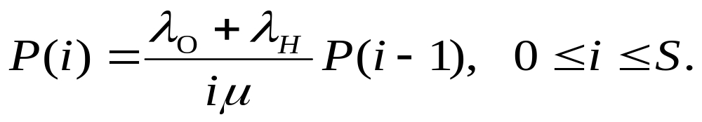
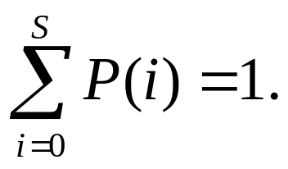
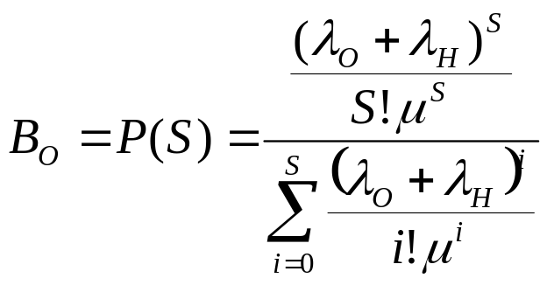
*** SKIP *** Analysis Model (cont’d)
The state equilibrium equation for state i can be given as
And the sum of all states must to be equal to one:
The blocking probability when all S channels are busy, can be expressed by:

Slide 50
*** SKIP *** 8.7.2. Modeling for Channel Reservation
(for Handoff Calls)
Why should we provide a higher priority to handoff calls?
From users’ view, the dropping of handoff calls is more serious and irritating than the blocking of originating calls.
How to provide a higher priority to handoff calls?
One approach is reserve S_{R} channels exclusively for handoff calls among the S channels in a cell.

Slide 51
*** SKIP *** System Model
S
.
S_{C}
.
.
2
1
λ_{H}
S_{R}
μ
λ_{O}
Channels
System model with reserved channels for handoff
(No blocking till less than S_{C} channels are busy)

Slide 52
*** SKIP *** Analysis Model
λ_{O}+ λ_{H}
λ_{O}+ λ_{H}
λ_{H}
λ_{H}
0
· · ·
S_{C}
· · ·
S
μ
S_{C}μ
(S_{C}+1)μ
Sμ
State transition diagram

Slide 53
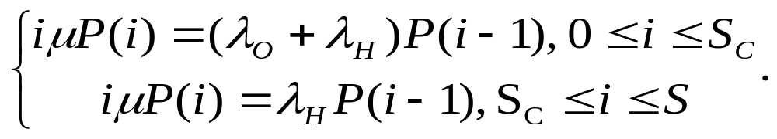
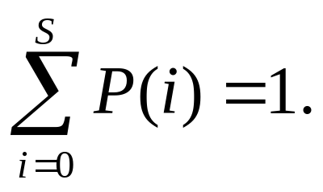
*** SKIP *** Analysis Model (Cont’d)
The state balance equations can be obtained as
and

Slide 54
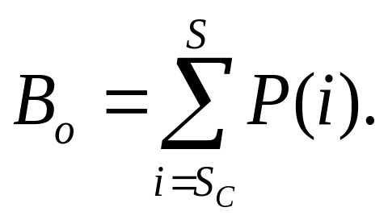
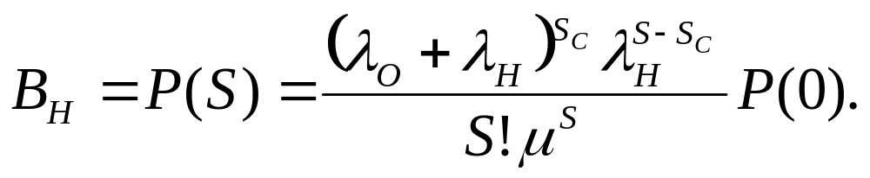
*** SKIP *** Analysis Model (Cont’d)
The blocking probability B_{O} for an originating call is given by (at least S_{C} channels busy):
The blocking probability B_{H} for a handoff call is (all S channels busy):

Slide 55
The End of Section 8 (Ch. 8)

